Slide 1


Slide 2

          Transforming
          for 21st century learning
          Bani Paintal Dhawan
          Head of Education
          Google India
Notes:
At Google For Education, our goal is to help more students feel engaged and love learning, to encourage their curiosity, to let them work together, to explore and create, to learn everyday. This afternoon, we have put together a solution showcase and the goal is to spark new ideas and provide insights that can enhance your existing education and technology plans.

Slide 3



AGB 18
LB 15
AL 12
...no, we aren’t playing bingo!
Notes:
No this isn’t code and we aren’t playing Bingo….
AGB 18 Bell age when he built the initial idea for the telephone
LB 15 Braile age when he developed an alphabet for the blind
AL 12 Ada Lovelace age when she wrote the first algorithm
When we see such unbelievable talent at such a young age, we assume they are the exception to the rule. We call them prodigies. And back in the day, they probably were -- motivated individuals who pursued their curiosity -- despite limited access to information and resources.
But maybe there were “others” -- maybe,..... we just couldn’t “find them”.....it’s impossible to know the level of “talent” that didn’t have the opportunity to experiment, make mistakes and share what they had learned...
Today there aren’t just a few --- they’re all OVER THE GLOBE….with access to the world’s information and ways to explore, create and learn.
How can I say this?

Slide 4
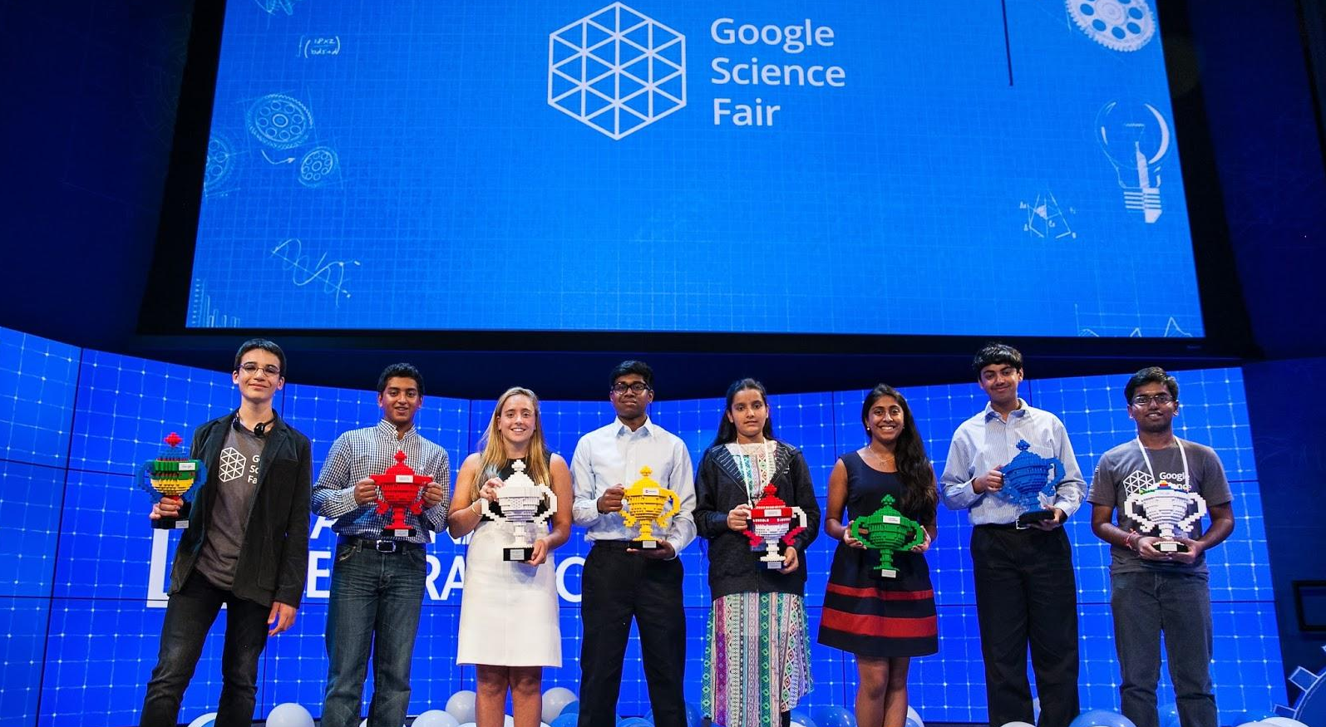


OH 16 | VK 15 | AC 13
Notes:
I don’t have to look any further than the Google Science Fair…our annual global online competition for teenage students
OH 16, VK 15, AC 13…..you know where I’m going with this…
Olivia Halsey (OH16) developed a rapid, inexpensive and accurate way to detect Ebola.
Closer to home, Viney Kumar (VK 15) from Sydney using mobile technology and GPS built an early warning mobile system for drivers
Anika Cheerla (AC 13) developed an automated method to detect Alzheimers...at 13!!
Now what is incredibly exciting about today is that more students have the opportunity to show us what they can do. We’ve received tens of thousands of applications from over 90 countries -- proposing unique solutions to today’s problems. For one science fair….
These solutions didn’t come from research scientists at universities. They came from regular teenagers at typical schools, who hang out with their friends and face the same challenges many students do today.

Slide 5
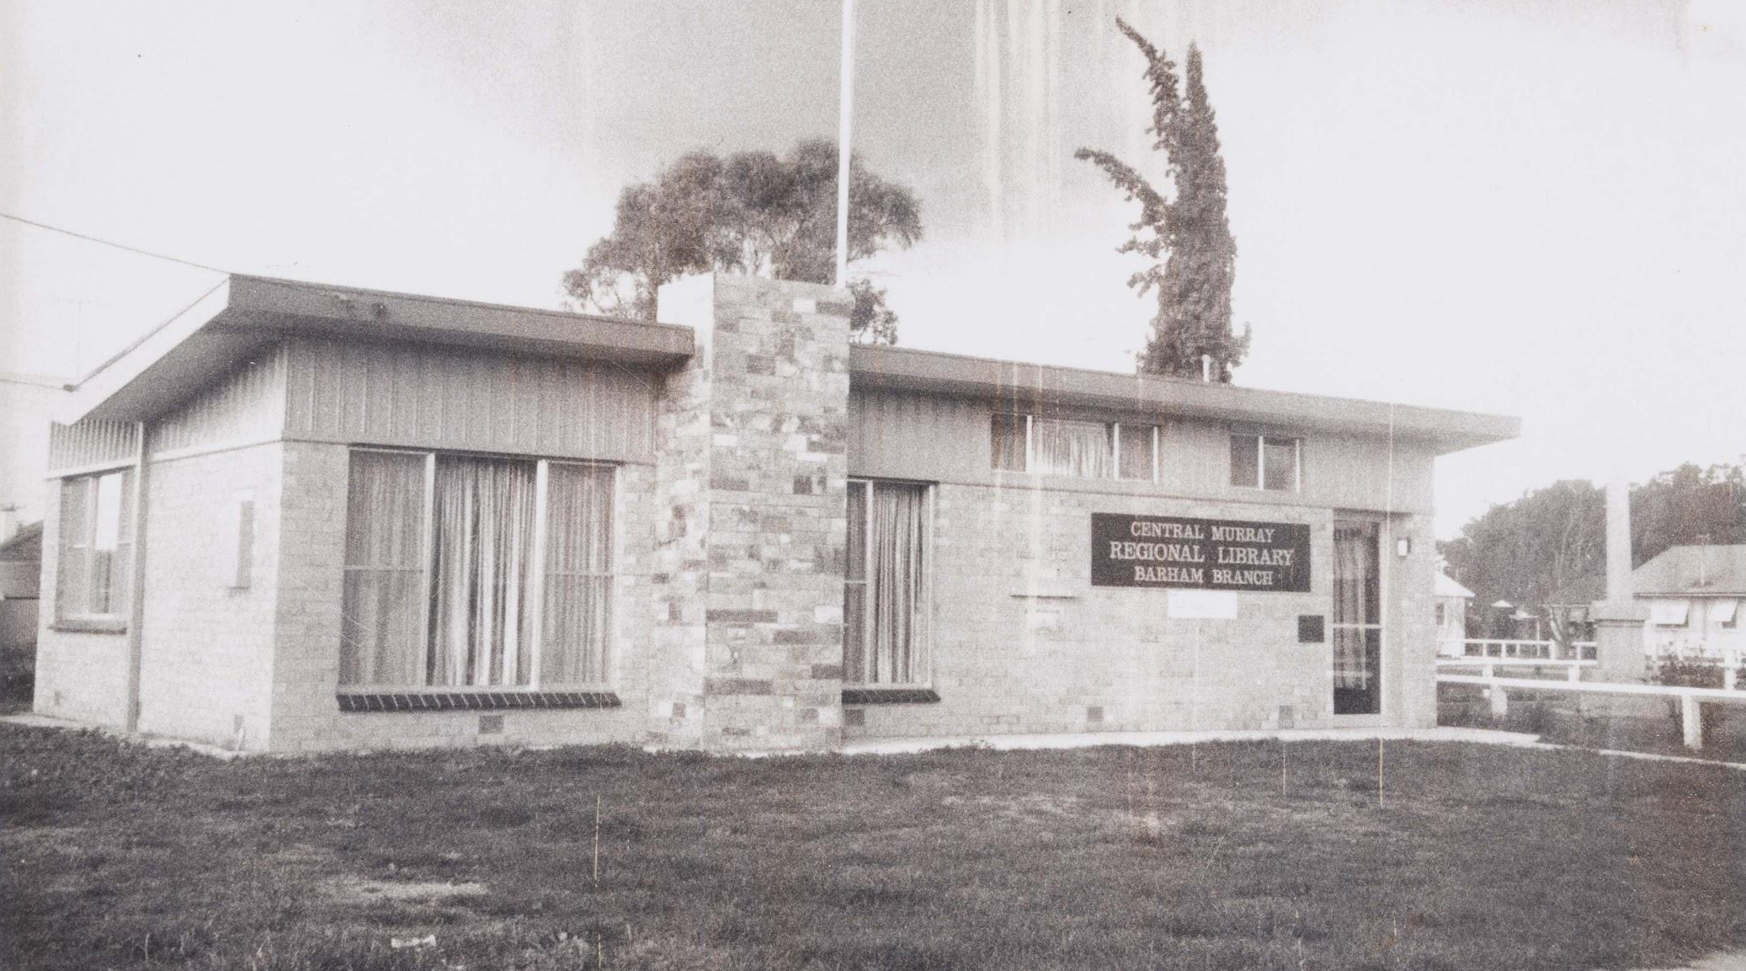
For most of history...
Notes:
For most of history
where you were born,
the family you were born into,
the resources at your disposal,
and your proximity to books and libraries -- were all factors that determined the quality of your education and shaped your success.

Slide 6
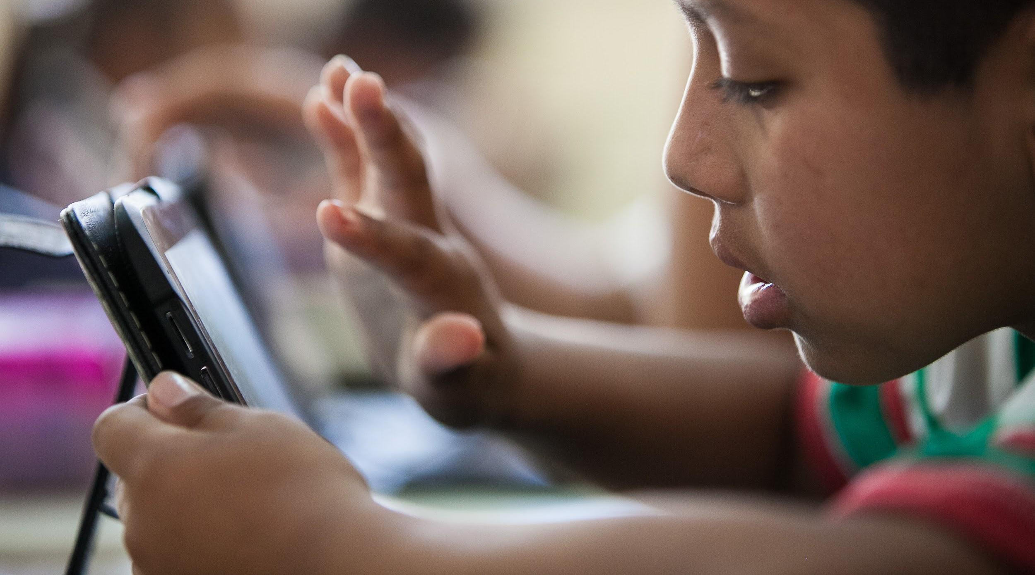
Now the world is at our fingertips…
Notes:
Today!! ... we have the equivalent of 100 million libraries in our pockets!
Technology and the internet are enabling us to redefine what being “educated” is today, allowing for greater access to information and enabling a much broader exchange of ideas.
When I think back to my past -- that little library in Long Beach, CA my world of knowledge…..and look at my kids current world; the avenues available to them astound me.
With a laptop or smartphone and online access,
you can create & share an idea,
build an app,
or start tackling a problem like Alzheimer's in an afternoon.

Slide 7

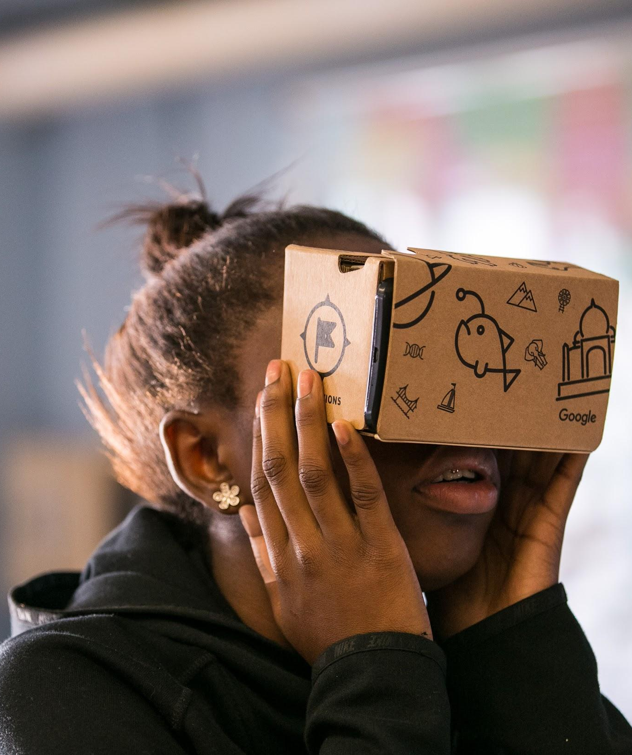

Empowering Gen Z
Preparing for
the future
Re-imagining today
Notes:
So how is the internet and technology redefining teaching and learning?
In the next 20 mins I’ll talk about three ways technology is shaping the educational landscape:
Empowering gen z
While Preparing for the future
And allowing us to Re-imagine today

Slide 8
Empowering Gen Z
Preparing for
the future
Re-imagining today
Notes:
Let’s start w/ Gen Z

Slide 9
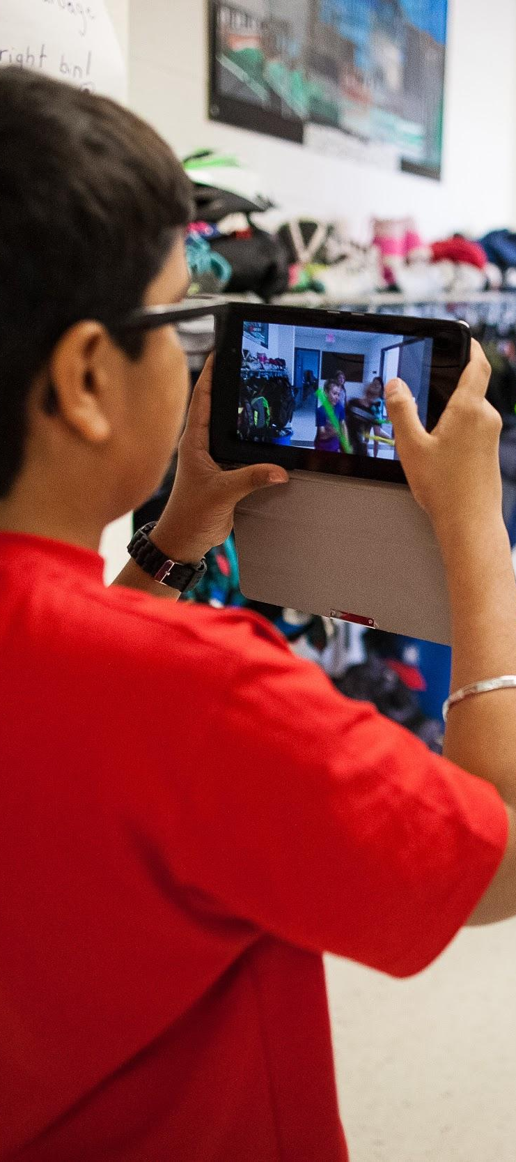
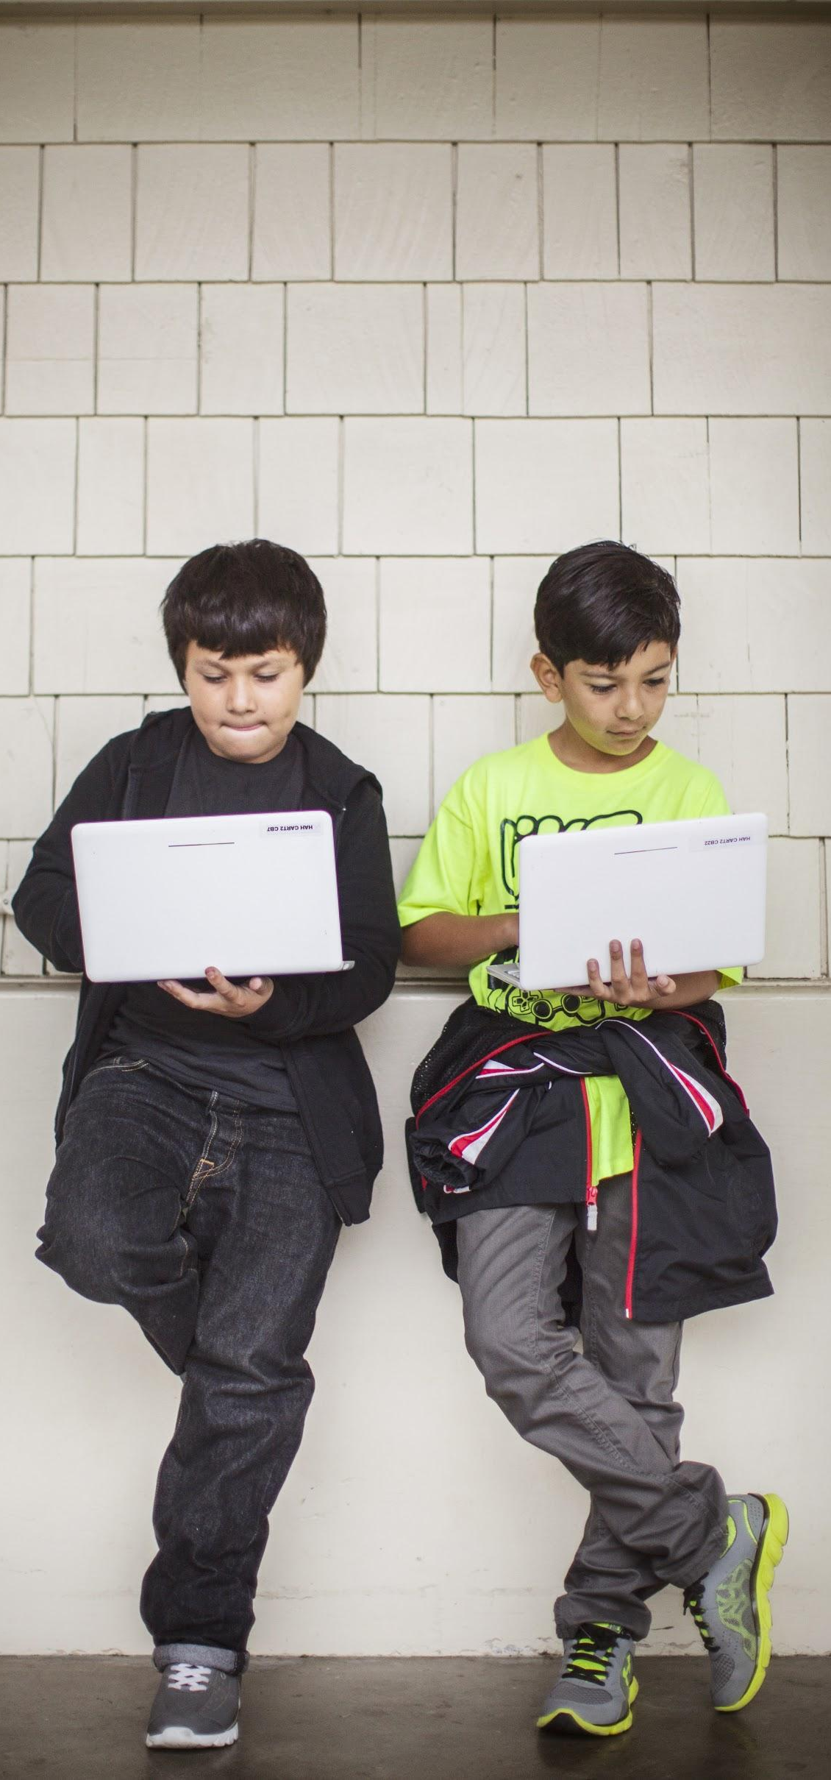
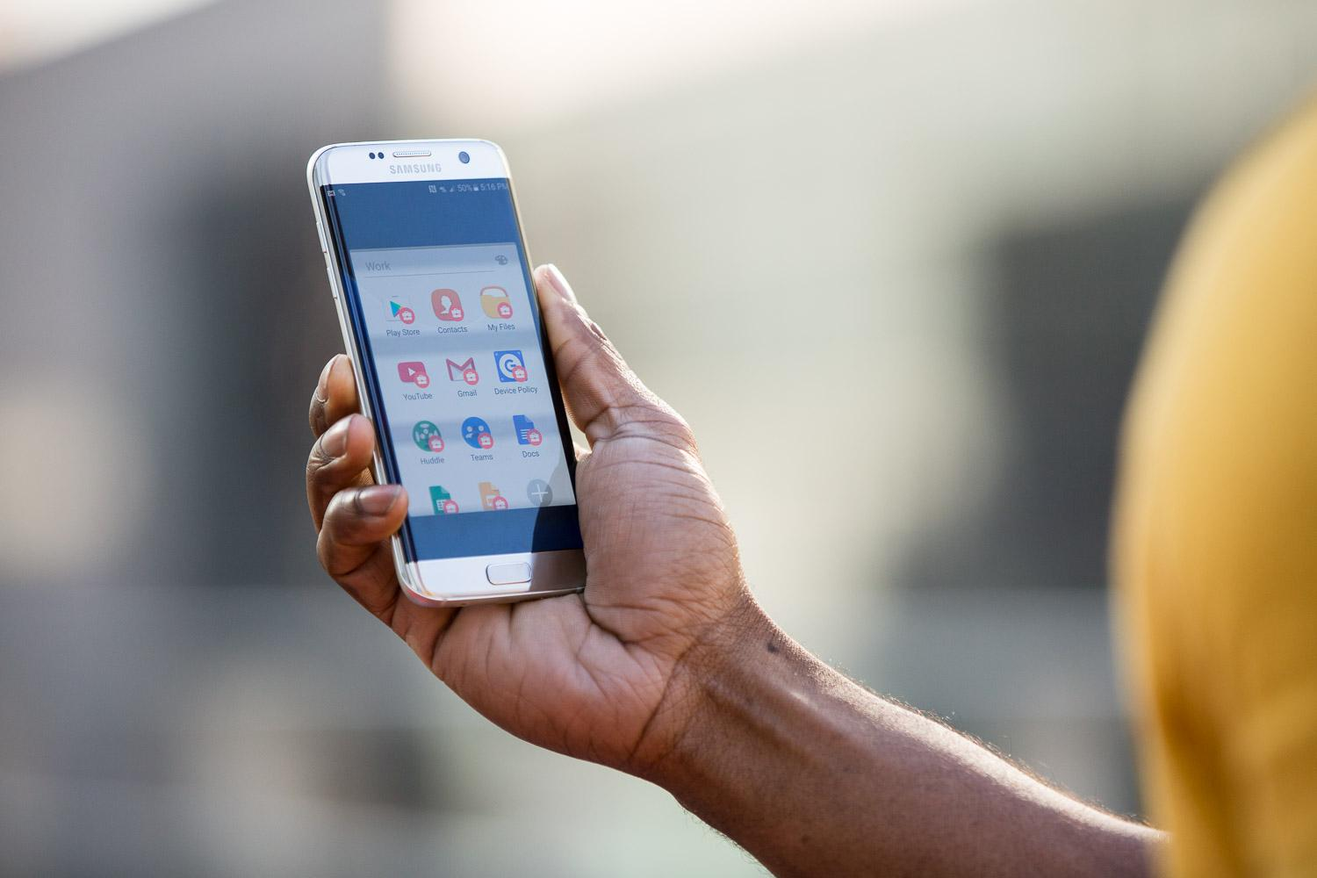
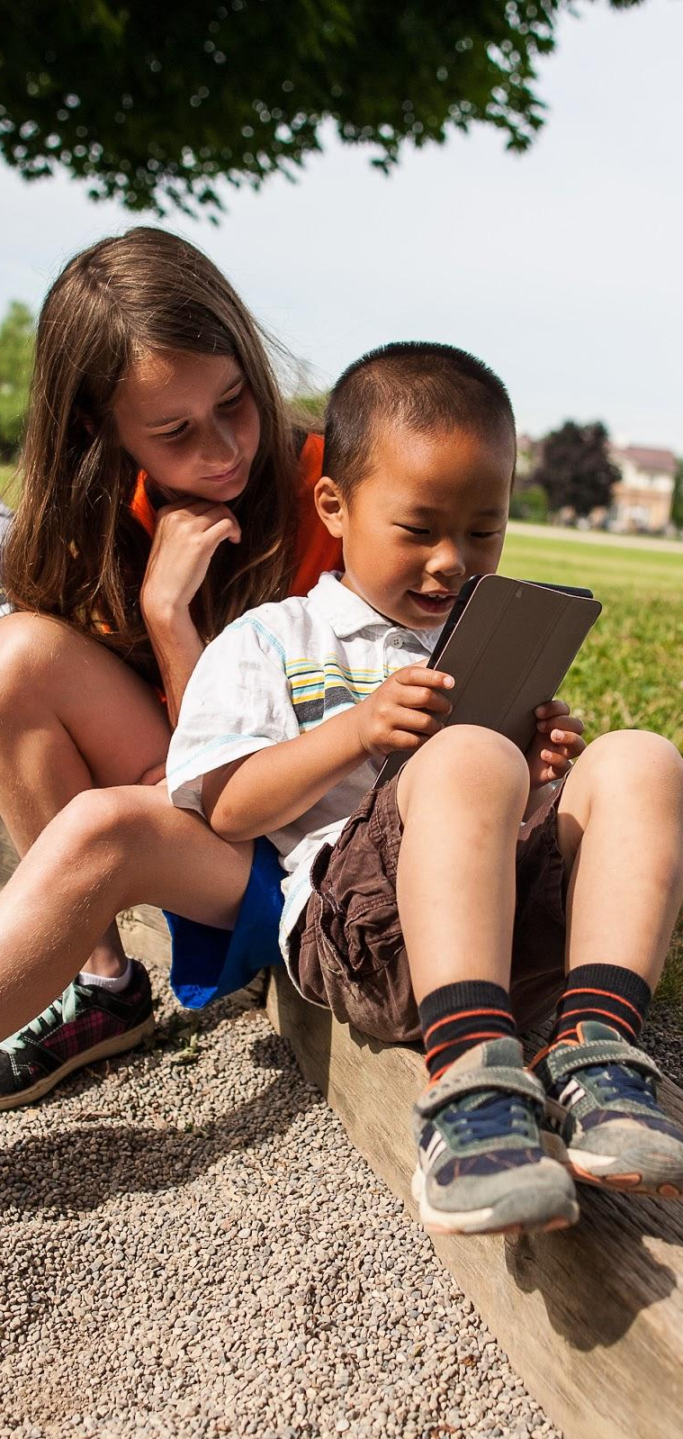
Empowering Gen Z
Technology is everywhere
Notes:
I think we all can appreciate how technology and the web have attached themselves to many parts of our lives.
Let me ask you all a question. Who hasn't been on the web today?
Many of us are on the web seconds after we wake up. We wake up, fire up a device and we’re engrossed.
It’s become the new morning coffee
Checking our email, the fastest way to the office, or reading the latest news…...it all happens before our feet hit the ground.
For today’s students, level of engagement is easily 10 times greater…….

Slide 10
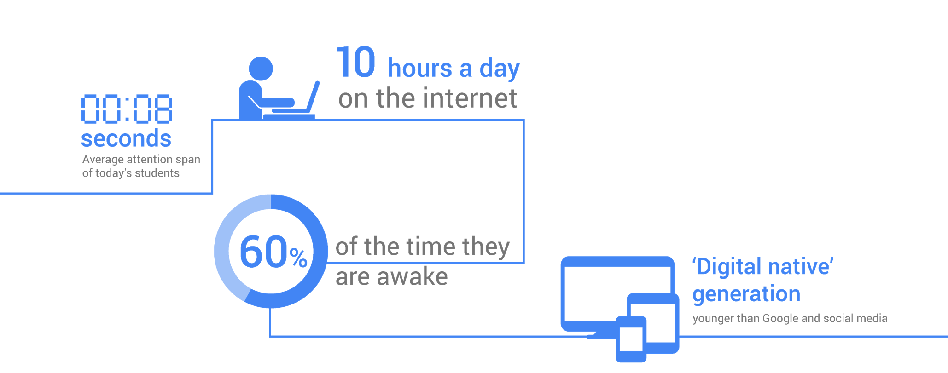
Empowering Gen Z
10 hours a day
on the internet
seconds
ave. attention span
of the time they are awake
‘Digital native’ generation
younger than Google
Generation Z
Notes:
We’re all into our smartphones, but here’s some mind boggling facts about GenZ students.
The avg. attention span...of students today... is as long as it took me…to finish this sentence
They are on the internet 10 hours a day which is close to 60% of their waking hours
They’re tech savvy -- we’ve all seen how comfortable they are navigating smartphones and tablets.
This is a ‘digital native’ generation, a generation younger than Google and social media.
Technology is already such a big part of their lives. Our challenge is to make sure we’re “engaging them where they live….”
Let me share a great example of how technology is changing the way students learn today …..

Slide 11
Empowering Gen Z
Preparing for
the future
Re-imagining today
Notes:
Now let’s shift gears and talk about the future.

Slide 12
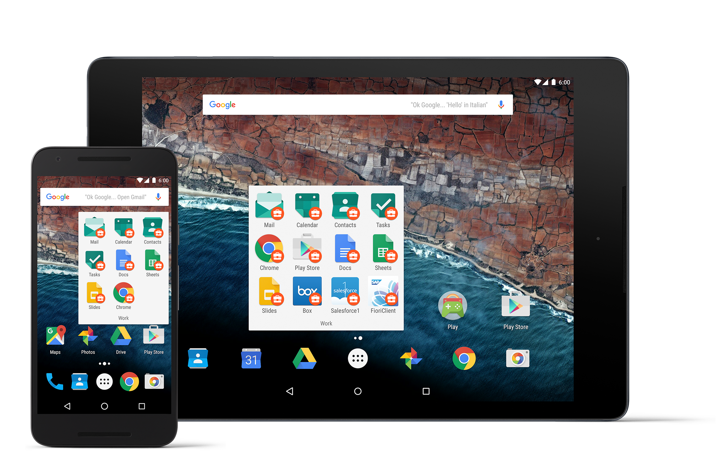
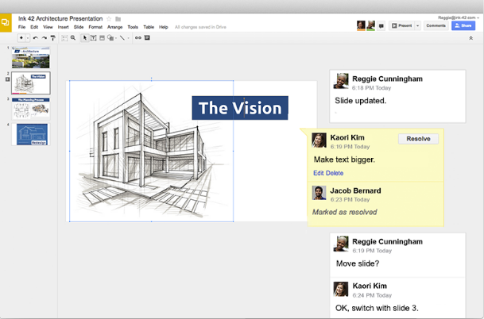

Preparing for the future
Skills for the future...
Notes:
I’m sure all agree the world is continually evolving and unlimited access to information is creating very different opportunities to those in the past ...
In the past, people may remain in jobs for 30 years or more, then retire. They’d likely have stayed with the same employer - like my father.
No one will be immune to this trend -- we experience it at Google as well.
This shift in job type and tenure -- changes how we best prepare students...
They need skills that enable them to adapt and to evolve.
So how do we help prepare them and instill the most appropriate future skills?

Slide 13


Preparing for the future
Top skills currently needed in the workplace
51%
Problem solving
33%
Team-working
26%
Communications
21%
Critical thinking
18%
Creativity
15%
Literacy
15%
Digital literacy
14%
Leadership
14%
Foreign language
7%
Emotional intel.
2%
N/A
Notes:
When the Economist Group asked business leaders to pick the top three skills needed in the workplace -- they responded overwhelmingly with Problem Solving, followed closely by Collaboration {Team-work/Communication} and Critical Thinking.
As technology evolves around us, the type of work done by people will of course change… but the need for these skills will continue to be critical…..
Let’s take a closer look at these skills and the role technology plays in shaping them

Slide 14
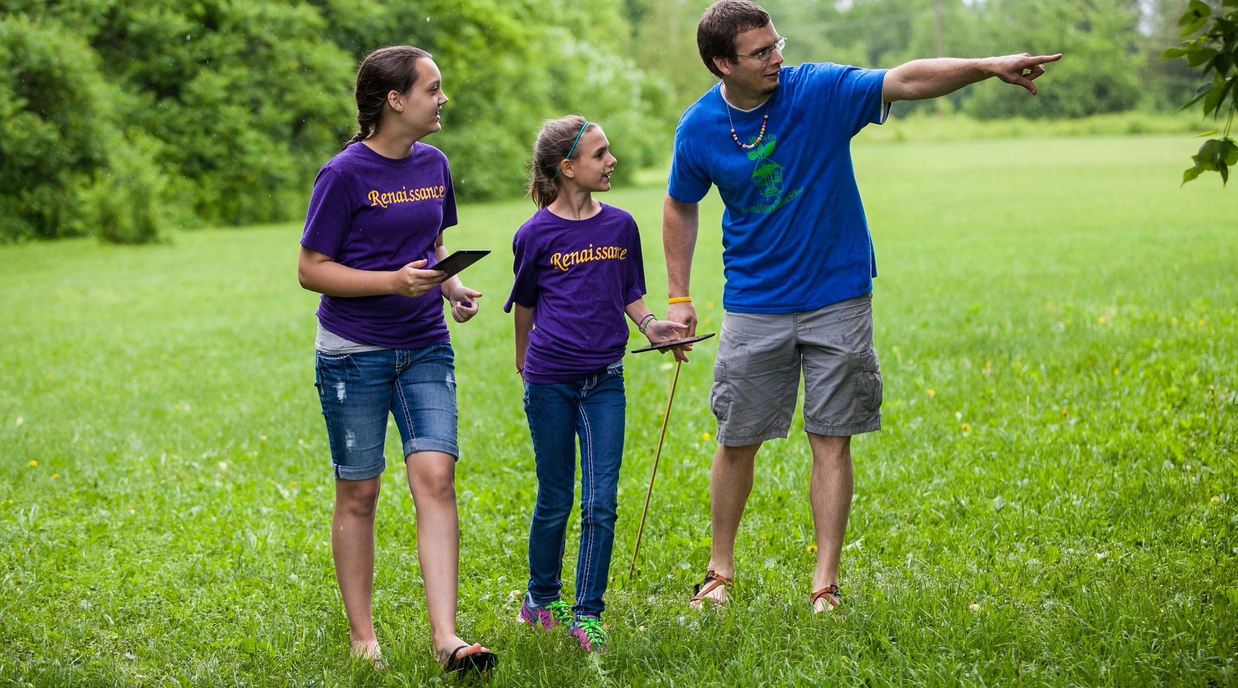
Preparing for the future
Converting information into intelligence
Notes:
The ubiquity of information is POWERFUL…..it can also be daunting.
The world’s information is at our fingertips, but how do we decide which information to use?
It started in a computer at a desk, moved to a laptop in our briefcase and now it’s in your phone in your pocket. Next step on your wrist or perhaps in front of your eyes
With increased access to information, the world will change - but using that information effectively is a skill that will need to be learned
Being able to think critically as students process a sea of information, judging what to use and how to use it -- will become a “basic skill”.

Slide 15

Preparing for the future
Collaboration is the new normal...
Notes:
Innovation today is a global process.
[Power of and necessity for collaboration]. Supported with an example from Google:
Let me share what I’ve experienced…...
<Anecdotal example of having to work with people in different time zone, culture, language.>
Diverse teams, collaborating on projects across physical and time boundaries, contributing varied expertise and perspectives to jointly solve problems.
This is how innovative teams are working together today --- and many more companies are embracing this reality of distributed workforces and worldwide teamwork...

Slide 16
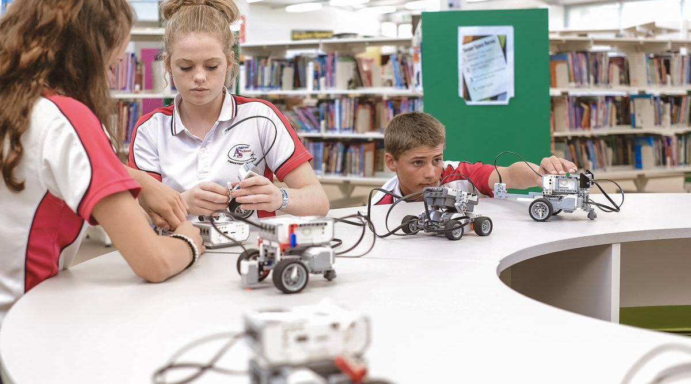
Preparing for the future
Generation of problem solvers
Notes:
It is hard to define how exactly to teach a student problem solving.
As we have seen the future is constantly evolving and so today’s students don’t need to learn the answers for a problem, they need to learn how to find an answer for a problem
What they need is a framework to think.
So “What do you want to be when you grow up?” is a question for another time….
A more relevant question for today would be “What problems do you want to solve?”
Now let’s watch how Pt England in New Zealand is using tech tools to develop these skills in their students today

Slide 17
Empowering Gen Z
Preparing for
the future
Re-imagining today
Notes:
I’ve spoken about students and skills.
So “ how can we effectively employ technology to develop these skills in students today?”
In Australia and around the world, schools like yours are adopting a holistic approach to transforming education, integrating 3 crucial elements:
1 - redefining learning models
2 - supporting teacher development
3 - investing in the future

Slide 18
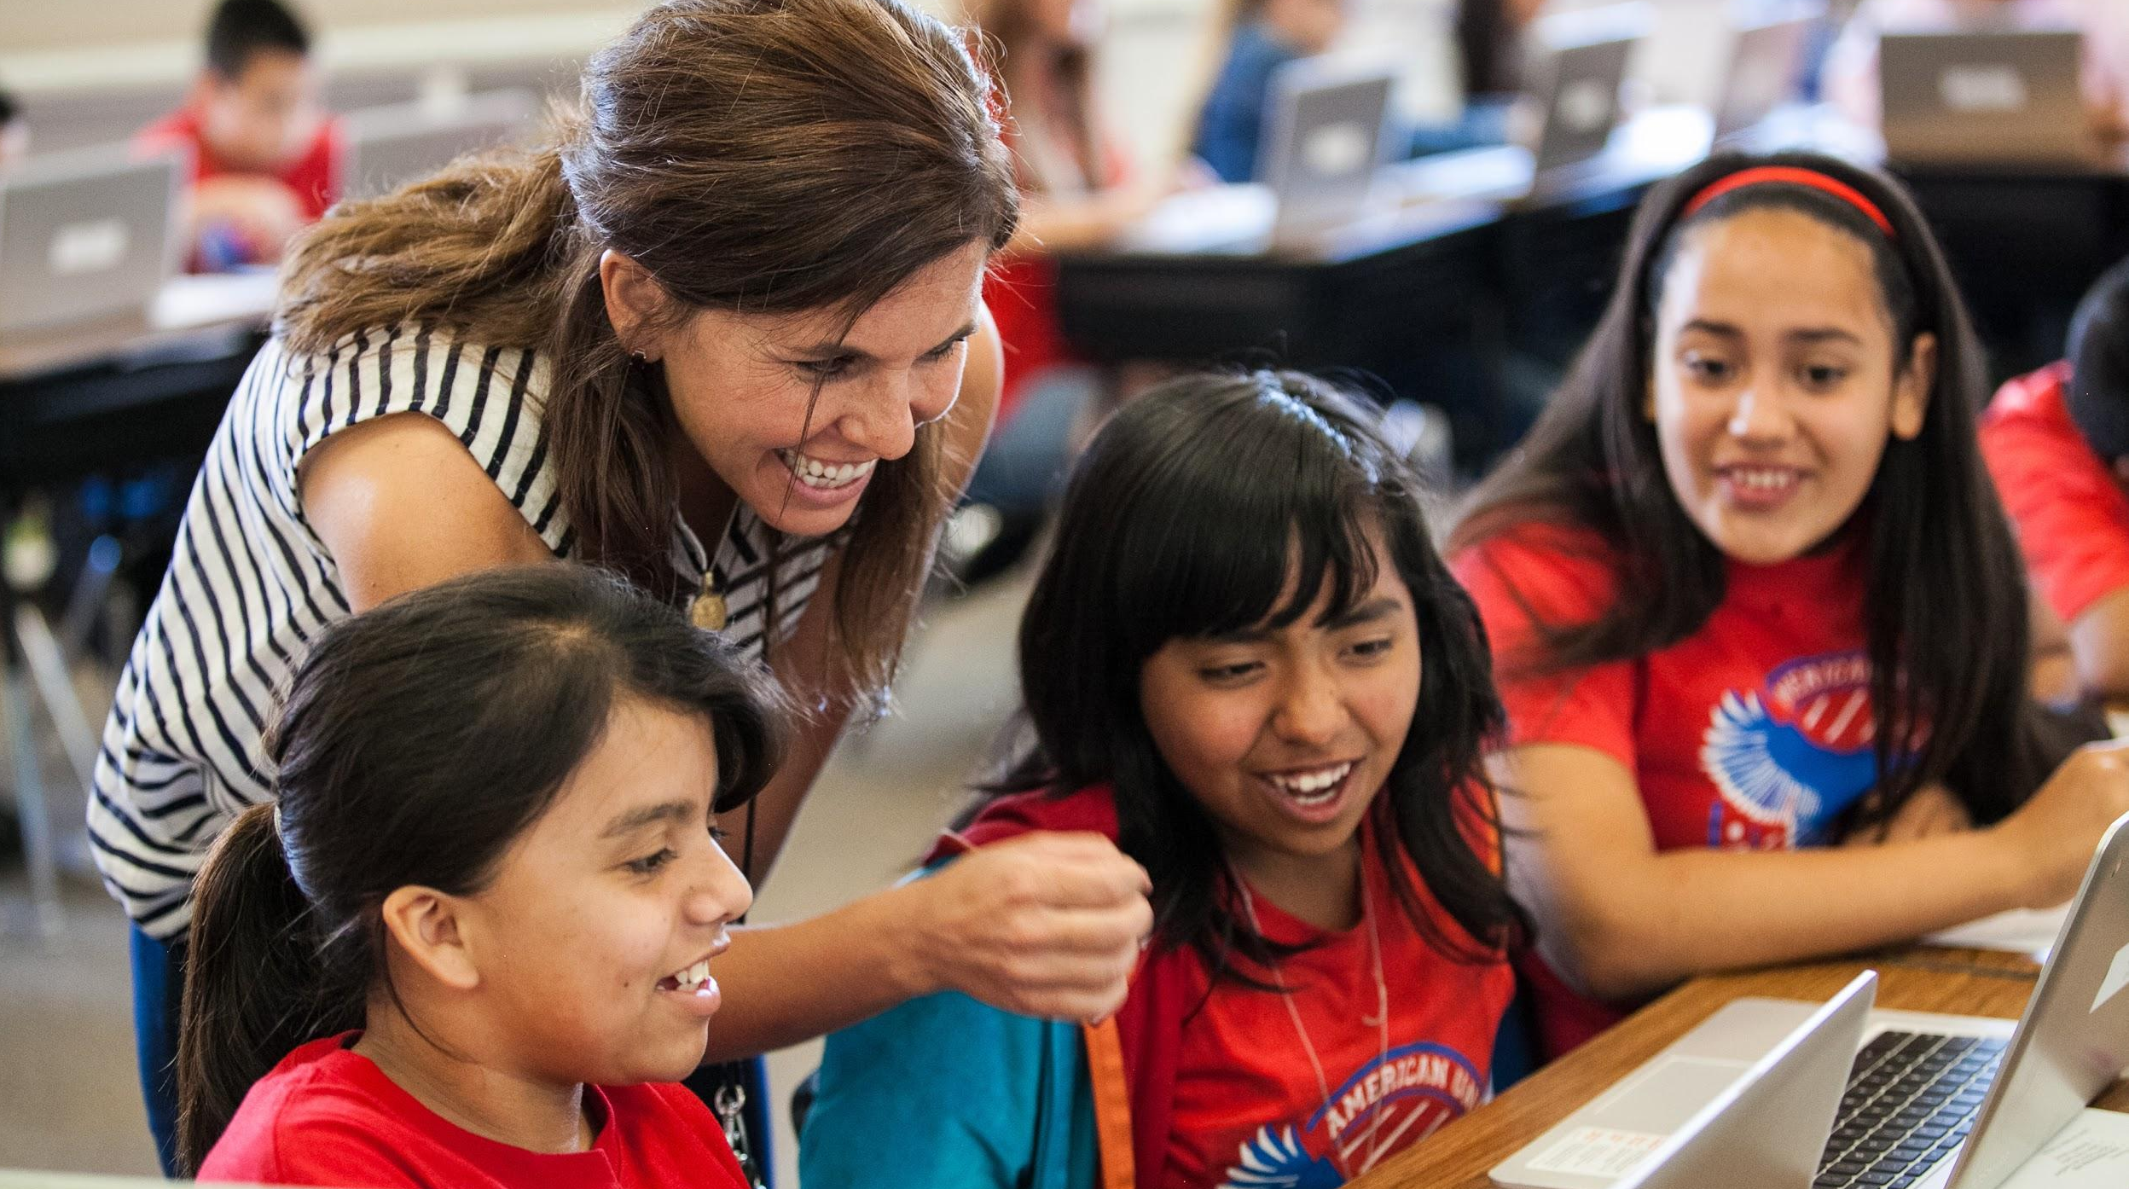

Re-imagining today
New models of learning...
Problem-based learning
Flipped classroom
Blended learning
Notes:
A fundamental feature of any learning model for building future skills is
Transferring ownership of learning from the teacher to the student. Teachers help students discover the curriculum instead of delivering it to them. Students pursue their interests in the context of the curriculum.
Teachers will become a “guide” for students, asking great open ended questions and modeling the learning process required to answer those questions.
Keeping this basic premise, some of the popular models that schools have successfully adopted are
Problem based learning: a multidisciplinary approach that builds very strong collaboration skills.
For example, a problem is defined as “building a fish tank” enabling students to learn math concepts while calculating area and volume, understand biological concepts by preparing the proper ecosystem for fish and aquatic plant-life and learn physics by observing how light bends in through the air & water in the tank.
Flipped classroom: Students receive their prep material as homework and class time is used for deeper and richer discussion. This model get students started on critical thinking.
Blended learning: which enables the best of f2f and tech enabled learning. This allows educators to teach a concept in multiple ways.
The good news is we are starting to see the impact of this in many schools today.

Slide 19

Student engagement improves 23% with 1:1 model
Kendriya Vidyalaya, India
Notes:
We’ve also seen how Google tools have improved student learning and achievement right here in India, in KV schools.
In 2014, KV in Delhi implemented 1:1 Chromebooks in grades 3, 5, and 7. They saw dramatic improvements in personalized learning for students with different learning styles
One particular student who never spoke up in class, never raised his hand was seen by teachers as disengaged and he began to lag behind for lack of participation.
After Chromebooks were introduced, this student started writing and commenting. He was able to express in writing what he was too shy to express in words.
KV’s research shows a 23 percent uplift in student engagement and a 55 percent increase in ease of explaining concepts with Chromebooks.
Private schools are moving to this model with Google. Here in Delhi schools like Sanskriti, Delhi public school, and RN Podar have already gone Google.

Slide 20
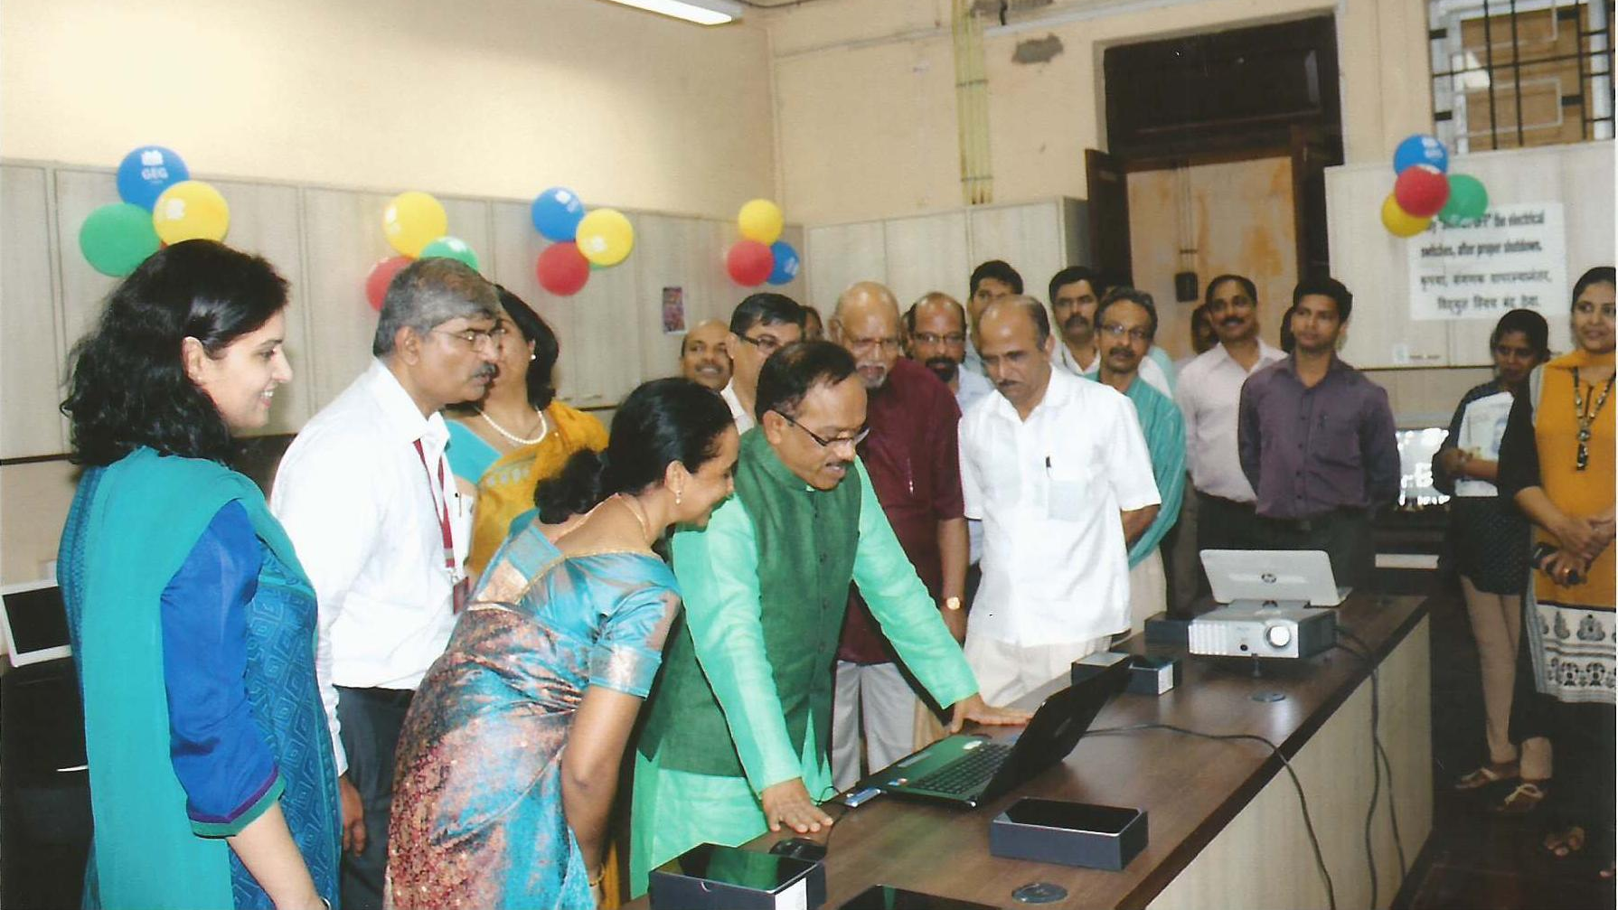
GEG communities inspires Goa’s state wide teacher training program
Notes:
In Goa, Google Educator Group communities have empowered 1500 teachers from 800 schools to create engaging lessons using Google tools. The success of this training and collaborative effort has inspired the Directorate of Education to invest in 6 learning centers to drive teacher enablement statewide.

Slide 21

A paperless pre-board exam saved USD 2M
Sao Paolo, Brazil
Notes:
We’ve also seen our solutions scale.
The state of Sao Paolo in Brazil was looking for a way to do large-scale assessments, affordably and without needing a ton of training. They turned to Google Forms, and created a model pre-board test for their PISA exam (programme for international student assessment.) The reporting from the forms was divided by schools, cities and regions, allowing stakeholders to quickly understand what’s going well where (and what isn’t.) They could also use this as a tool to quickly evaluate how teachers are doing.
Just 3 weeks after they decided to move to forms, 60k forms had been created and filled out by students. And within just a few months, they’ve been able to offer this online pre-assessment to 600,000 students. They have saved more than 2 million US dollars from making this change.
Forms is also a fantastic tool for driving personalized learning. Teachers can create quick assessment to check in on how well students are grasping the materials they are studying, and adjust their curriculum as a result. And in the US, beyond forms, Chromebooks have become a tremendous assessment platform for large-scale formal testing, because they are secure, fast and affordable to integrate with any testing platform.
<Promote demo zone on forms>

Slide 22
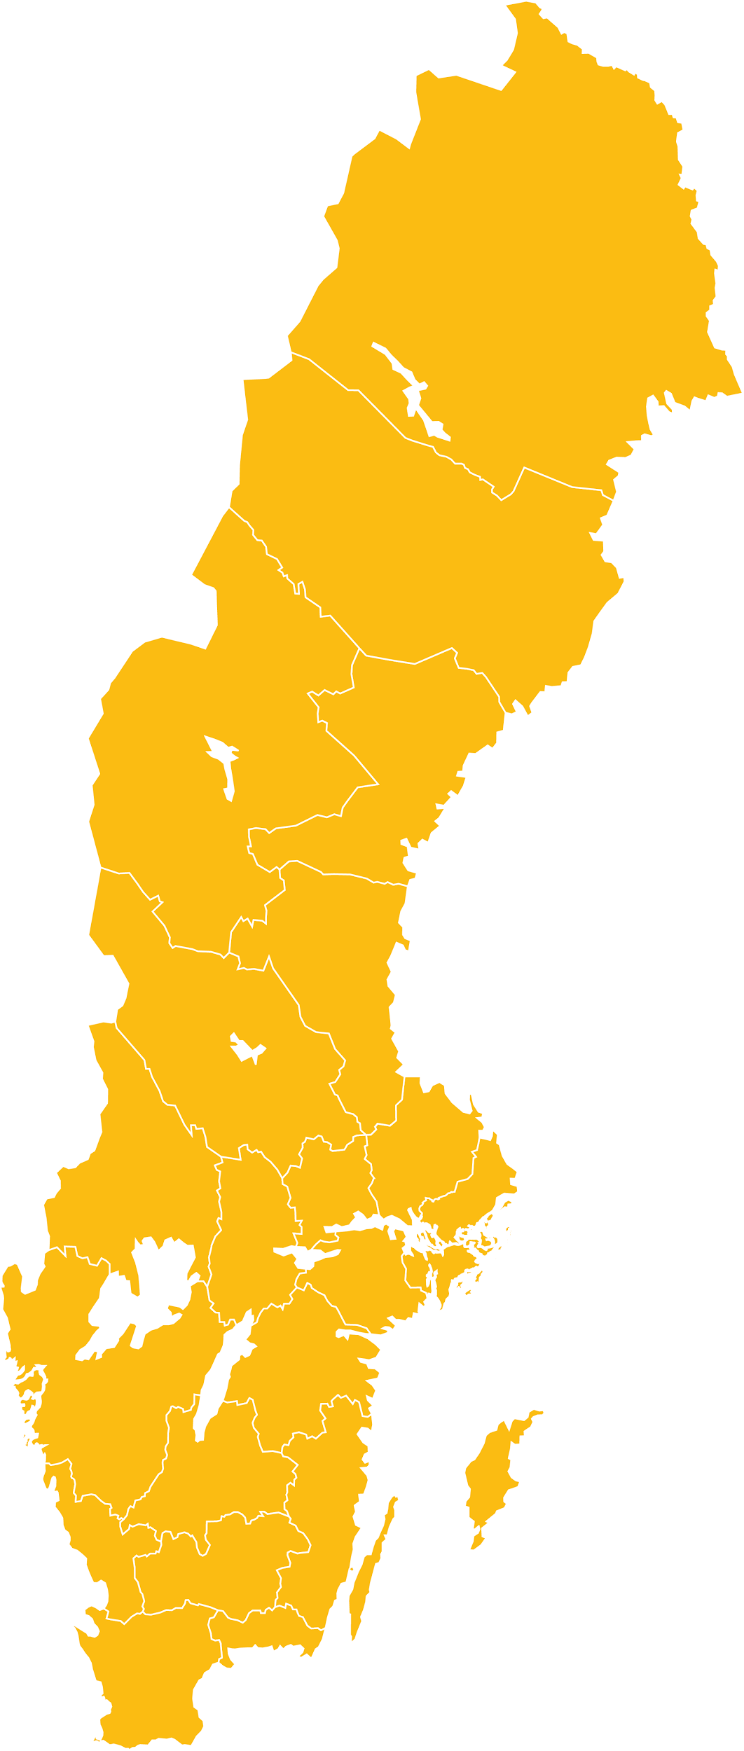
Re-imagining today
Sollentuna Municipality
Research found 10K students from 30 schools using a collaborative tech based learning model performed 19% better in literacy and numeracy.
19%
Notes:
Sollentuna Municipality schools
…. in Sweden achieved a 19% improvement in literacy and math scores by employing a collaborative learning model utilizing technology.
The model used Google Apps for Education, Chromebooks and other devices across 10K students in 30 schools to:
interact in real time with peers/teachers and collaborate on their approach to a problem
discuss what they had learned,
and provide feedback and assessment for one another

Slide 23

Re-imagining today
7-minute demos in weekly staff meeting
1 hour formal training every term
Techno-Breakfast twice a term
Southern Cross Catholic College
Weaving professional development into the school’s DNA
Notes:
There is no substitute for professional development -- Just like our students, teachers need on-going support. Once students are inside the classroom, the teacher is the single most important factor in their education.
Southern Cross Catholic College in Townsville weaved technical professional development into their schools’ DNA. They created advocates: “e-learning-guides” consisting of IT teachers and IT lovers.
They wanted to make sure development activities remained top-of-mind for their teachers, so they encouraged them to
Create 7-minute technology demos in their weekly staff meeting.
Organized a Techno-Breakfast twice a term to give another avenue for teachers to come and learn.
And every term they had a formal 1 hour training, centered on the use of tech in the classroom.
With all of these programs, professional development became an everyday “community activity”.

Slide 24
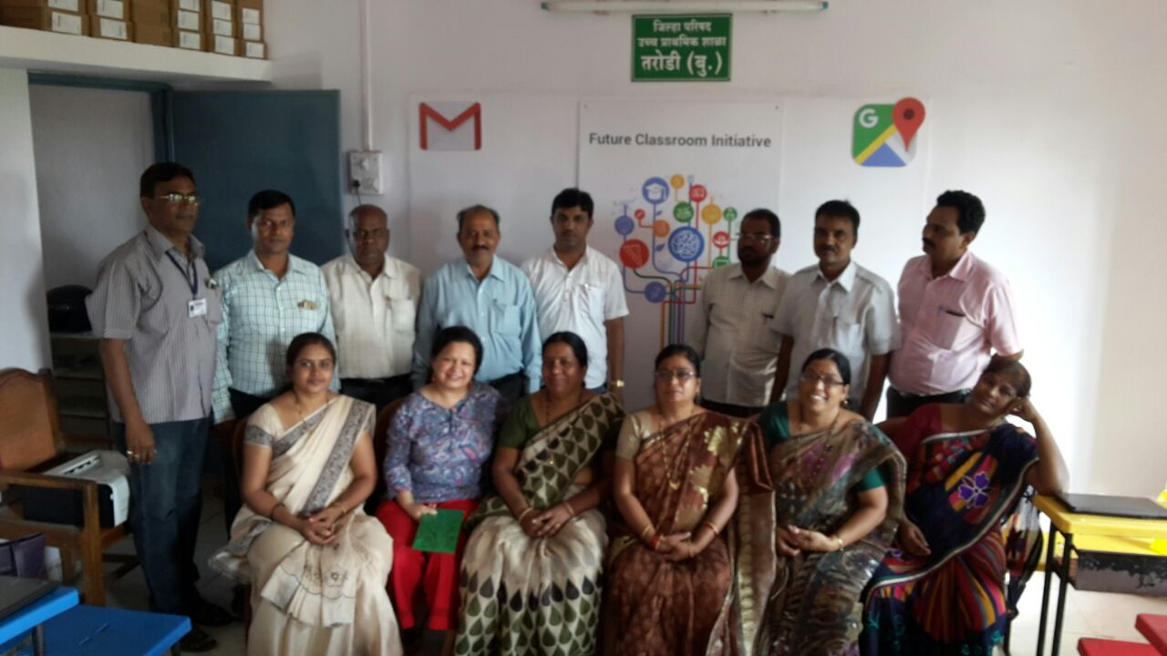
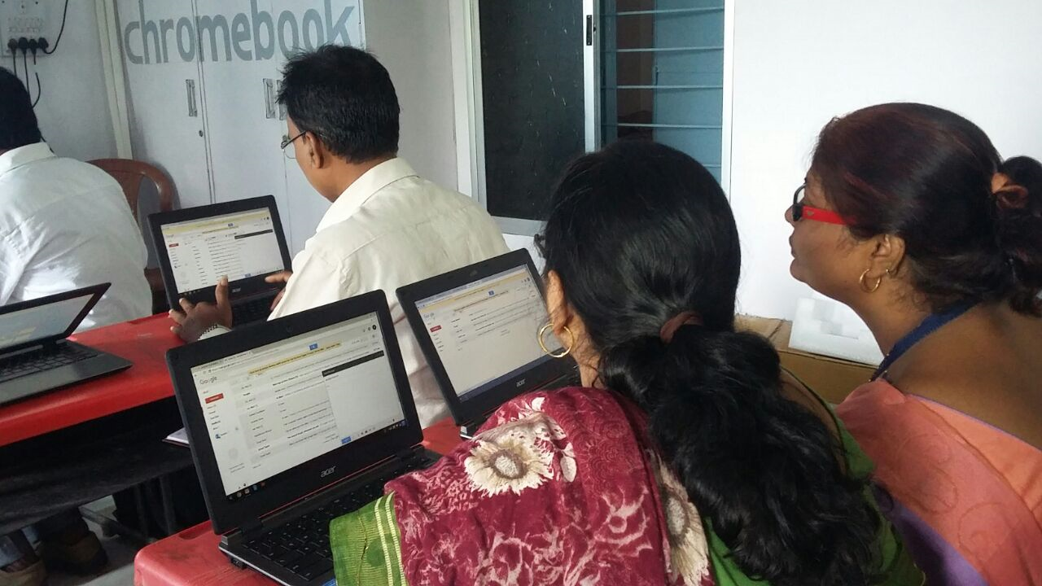
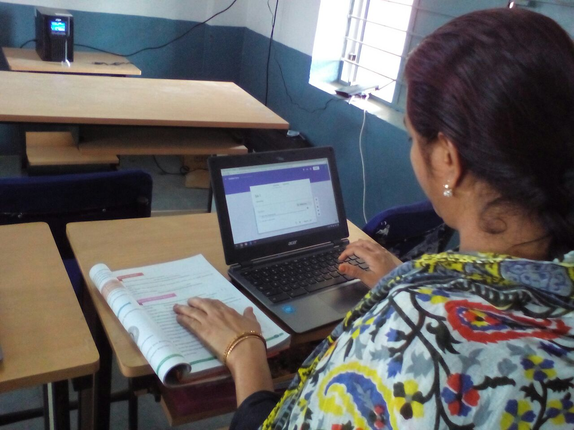
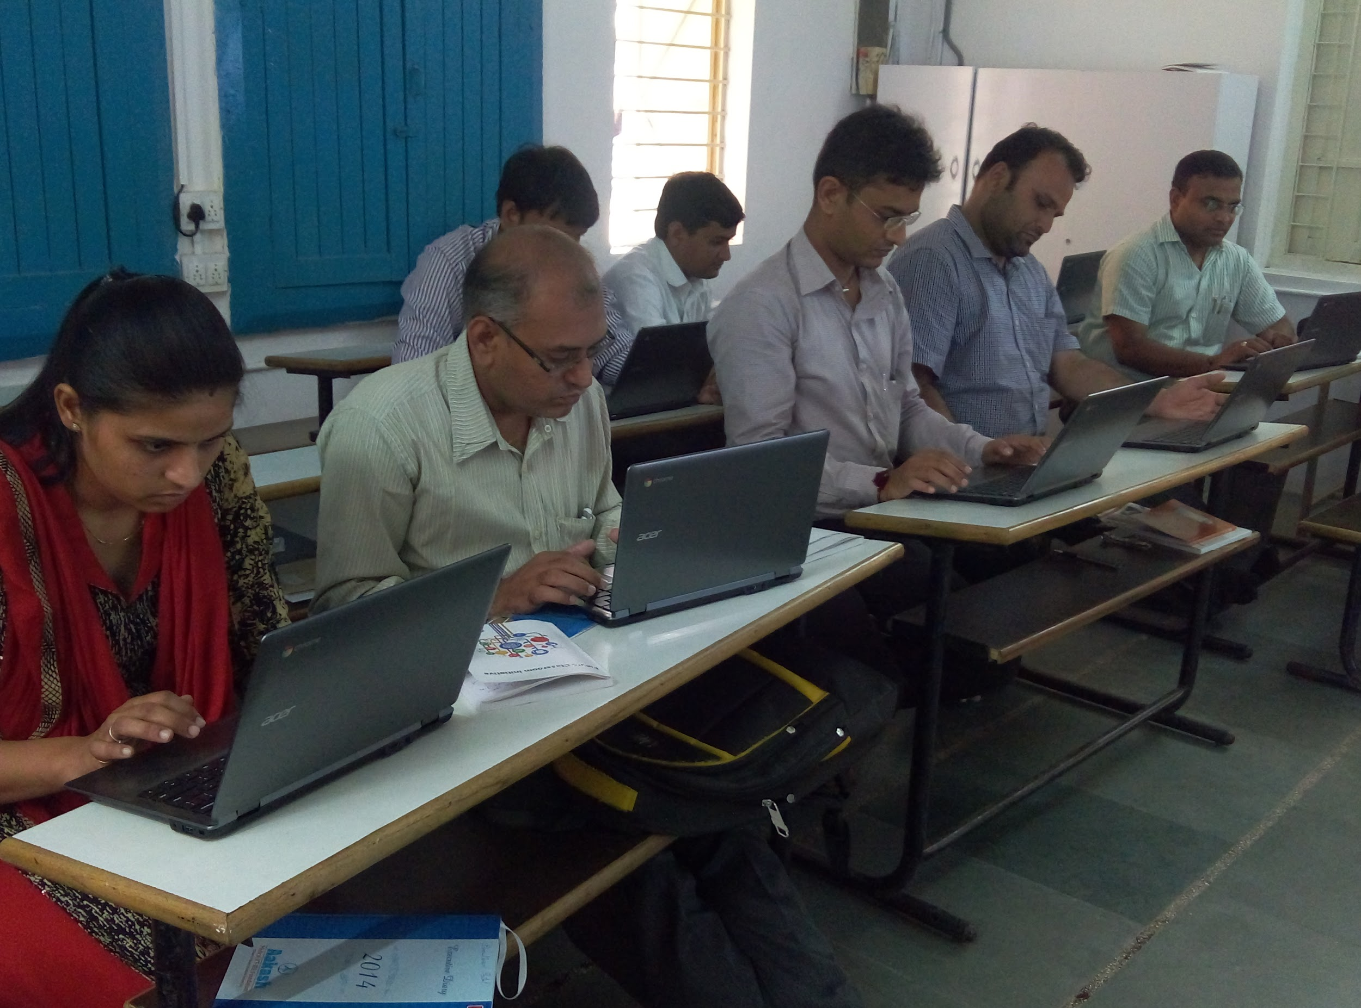
          Future Classroom initiative
          @ GHS School, Vijay Nagar, HYDERABAD
          @ ZP Upper Primary School,Tarodi, NAGPUR
          @ Chandlodiya School No 1, AHMEDABAD

Slide 25
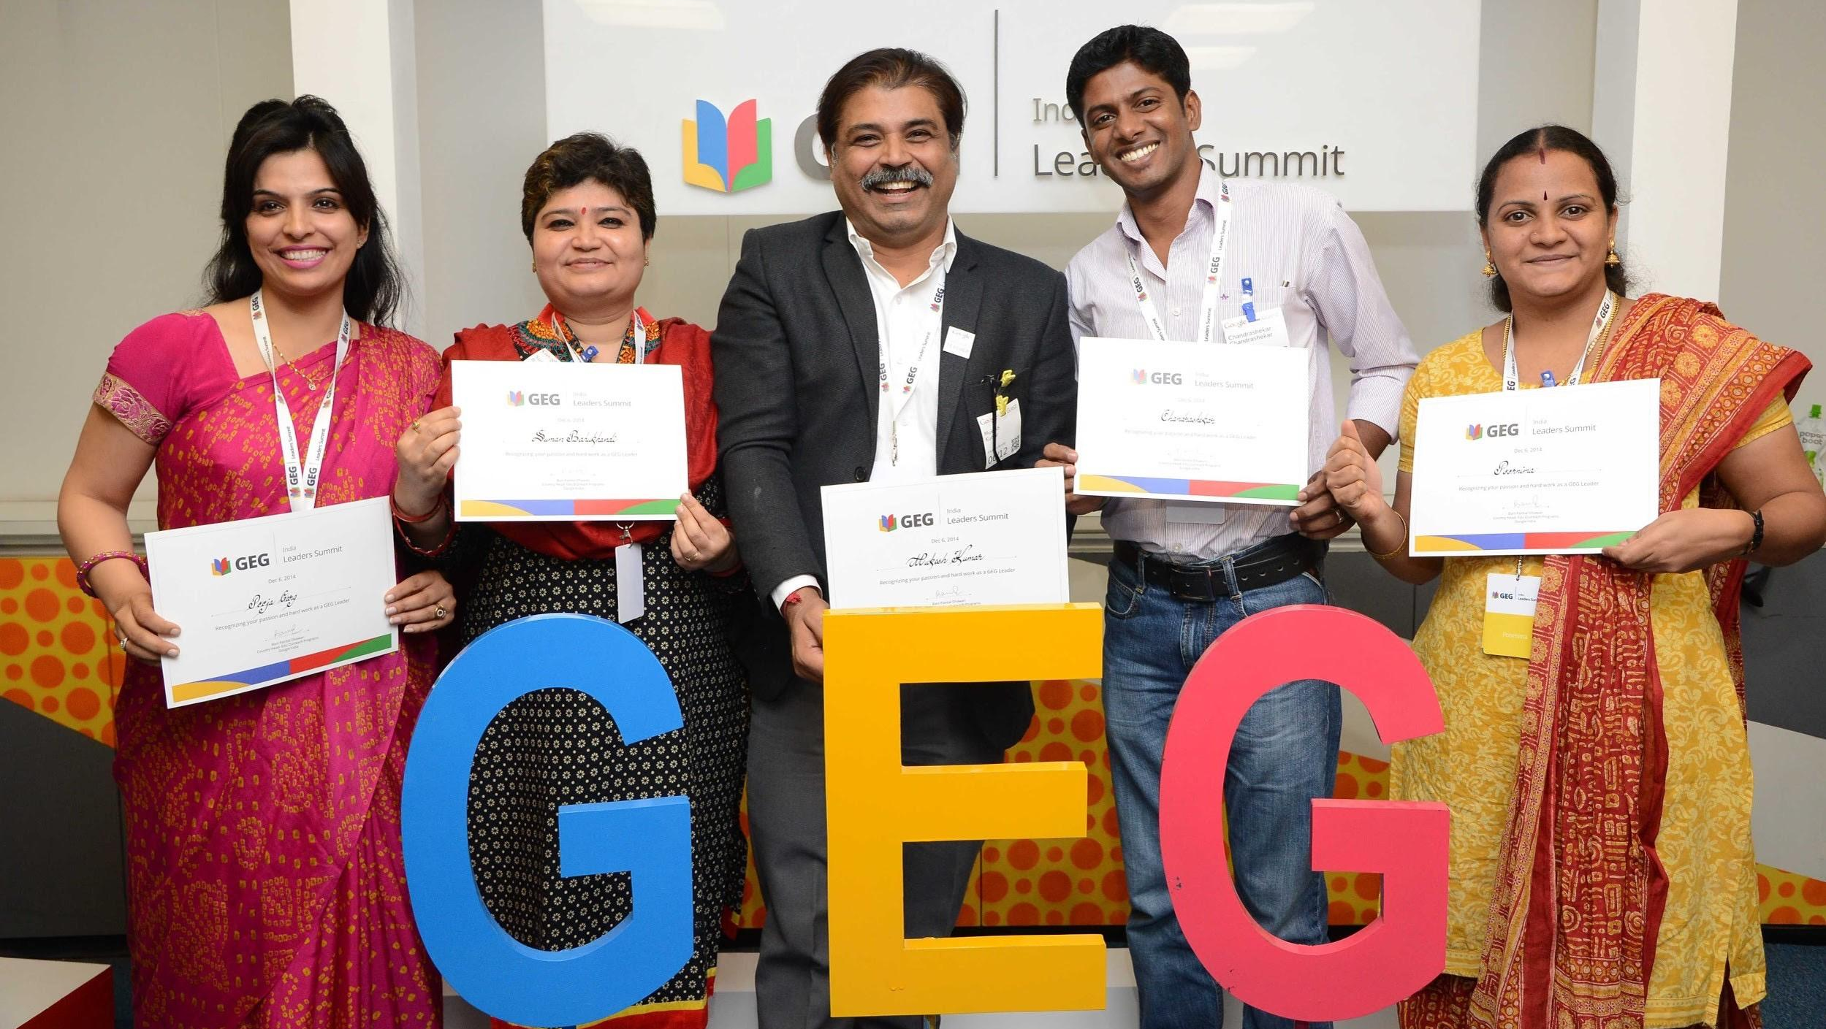
Re-imagining today
Google Educator Groups
Notes:
And what if teachers could learn not just from peers in their own schools, but also from other schools in the neighborhood or in the city or any part of the world?
We have seen great power in teacher networks -- every time we’ve launched Google Educator Groups in a country.
This is a community program for educators who learn, share, and inspire each other to meet the needs of their students through technology tools.
So a teacher in Chicago facing similar challenge as a teacher in Melbourne can exchange practical lessons that can be applied to upcoming classes.
Today, Google Educator Groups are active in 38 countries we have 8 chapters in Australia and 6 in New Zealand.

Slide 26

Re-imagining today
Investing in the future...
Sustainability
Equity
Impact
Notes:
We saw earlier why technology plays an important role in preparing today’s students for tomorrow.
Let’s be clear -- technology is the last piece in the puzzle.
Once agreed learning goals are in place and your teachers, students and parents are ready for the challenge, here is a framework you can use to evaluate tech tools:
A technological solution we should satisfy three key attributes: Sustainability, Equity and Impact
Is the solution sustainable? How are we defining this...
Is it simple to use
Is it flexible, can it change with the times
What are the recurring costs to maintain a solution? Our surveys show close to 40% of schools indicate budgets as their biggest barrier. So that recurring cost element is a critical consideration.
Is your solution promoting equity:
Is the available for every student in your school
If you have a BYOD model, is there a loaner or funding program to support the less affluent students -- this also applies to connectivity and content as well as devices.
Finally impact matters the most:
What are you accomplishing above and beyond your current program by introducing technology?
How are the tools helping to build higher order skills?
How can the use of tech build on learning models I discussed earlier.

Slide 27



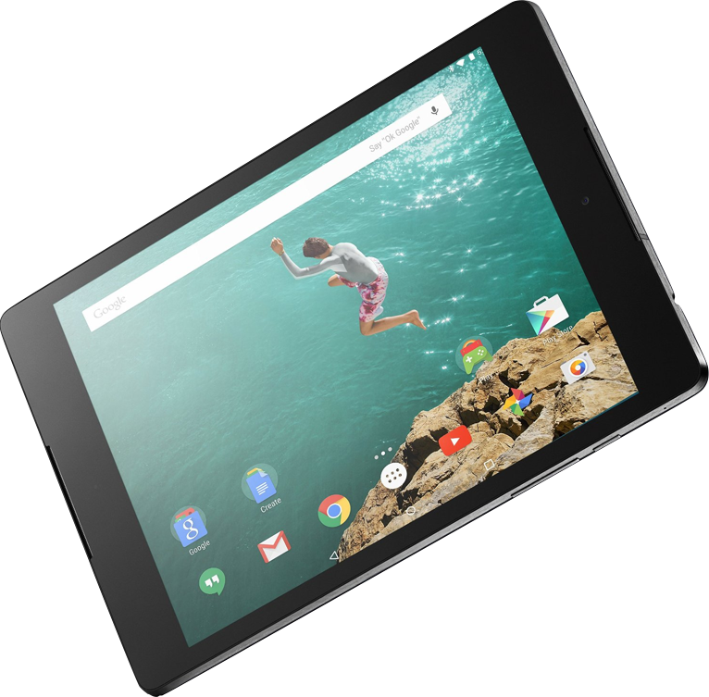


Re-imagining today
The best of Google,
for educators and students
Google
Classroom
Google Apps
for Education
Chromebooks and
Android tablets
Expeditions
YouTube
Collaborative
platform
High speed
learning devices
Rich
content
Notes:
So where does Google for Education fit in all of this?
Our vision is to bring the best of Google to every classroom, budget-friendly and fine-tuned for educators and students.
I’ve talked today about a variety of schools and their approaches to using technology in education:
Collaborative platform
We saw how Emerging Sciences Victoria incorporate GAfE our productivity tools into everyday lessons….
We also give teachers a much simpler way to manage assignment workflow and interact with their students using Google Classroom.
High speed learning devices
We shared how Sollentuna and Pt England are creating engaging classrooms with easy to use, secure and affordable Chromebooks which last year became the top selling educational device in the US
Rich Content
We’re all familiar with YouTube; but did you know there are over 700k educational videos and many other avenues for sharing educational content on the platform?
And in the spirit of constant educational innovation, Google Expeditions, our first-class Virtual Reality experience for the classroom simple, affordable and most of all totally awesome.
But don’t take my word for it, I’ll let the students do the talking...

Slide 28
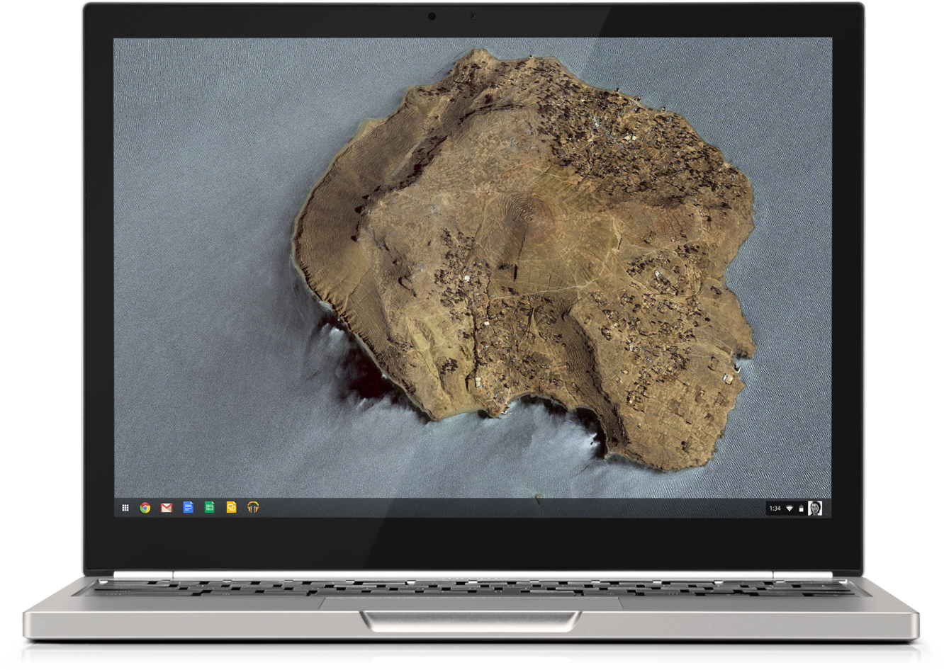
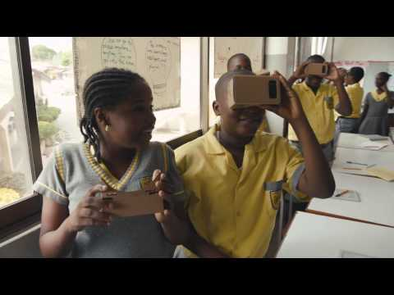

Slide 29
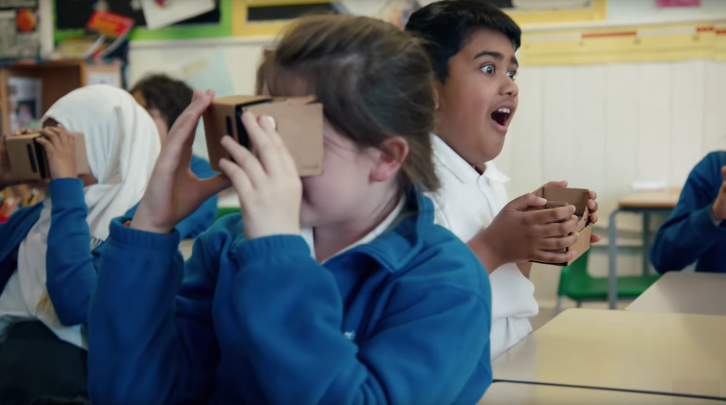
Re-imagining today
Notes:
I love this student’s expression -- this is what it looks like, when technology makes an impact on education.
Isn’t that a BIG part of what being an educator is all about... as Dorothy Burt so aptly put in the clip I shared…. “opening a world of amazing possibilities”?

